Slide 1


UE 1
CPU f₁^{l}
UE 2
Q₁
Q₂
CPU f₂^{l}
Q₃
…
UE 3
BS with MEC sever
Q_{N}
CPU f₃^{l}
_{Task Buffer Cache}
UE n
CPU f_{n}^{l}

Slide 2
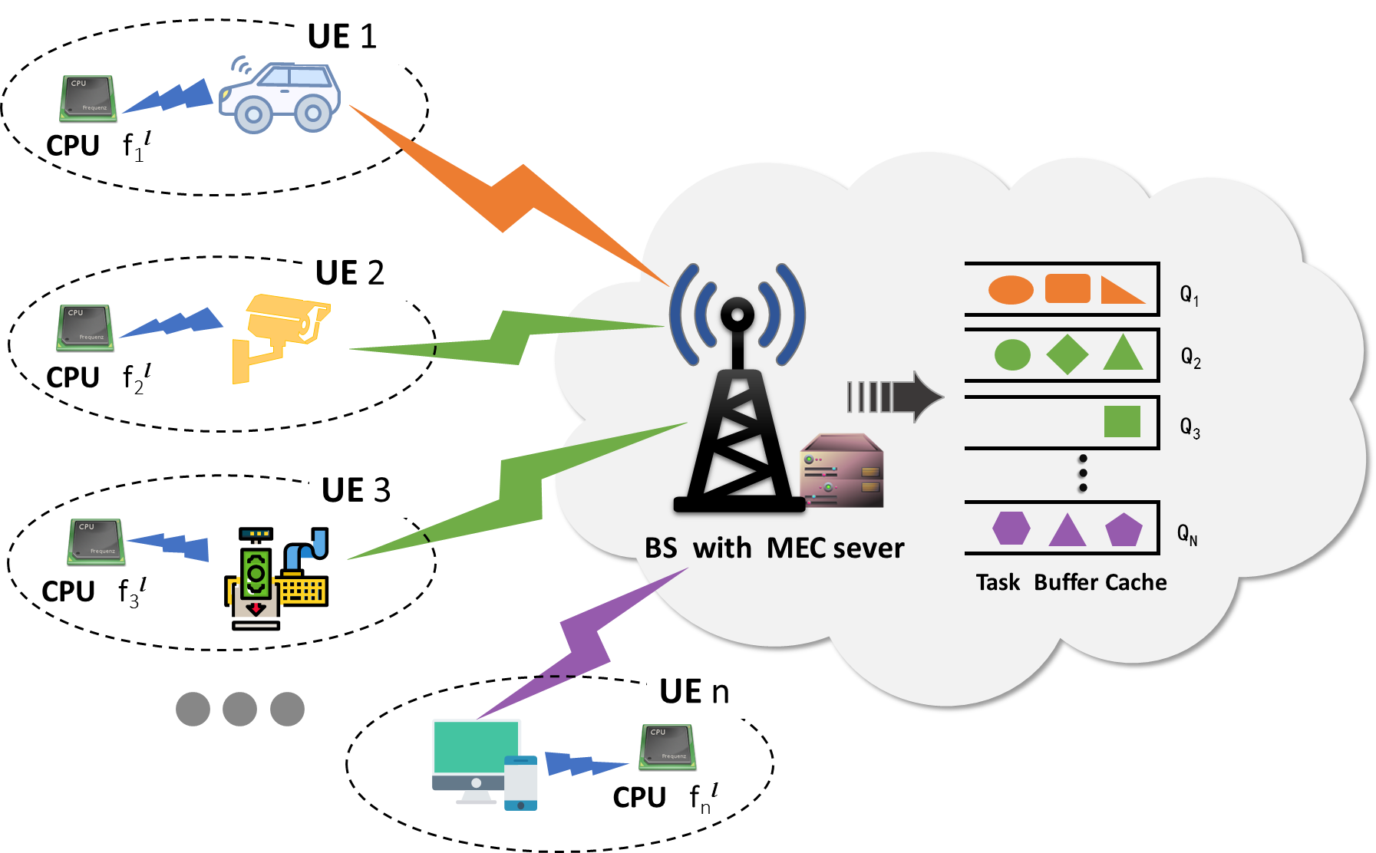
f_{N}º
f₃º
f₂º
f₁º
…
F_{ser}
Priority-based MEC Computing Resource Allocation
Local Execution
Offloading Execution
Best
Priority
MediumPriority
Worst
Priority

